Slide 1
Assignment 3: RL for Portfolio Management
ncu-ai-1131-ta@googlegroups.com
CE6020* Artificial Intelligence
TA: ncu-ai-1131-ta@googlegroups.com

Slide 2
Description
Data
The dataset comes from FinMind and contains approximately 8 years of stock price data, along with various financial indicators.
The training data consists of 8 different stocks over 1862 days ( 1862 * 8 = 14896 rows) .
The testing data covers 8 stocks over 233 days (1864 rows).
Task
Using Reinforcement Learning to make investment decisions on Taiwan stocks
The opening price ("open" column) is used as the buying price, and the closing price ("close" column) is used as the selling price.
Each purchase/sale will be charged a handling fee of 0.1425% and a selling transaction fee of 0.3%.
Evaluation
There is an initial capital of 10,000, and the capital after a fixed period of time is used as the criterion.

Slide 3
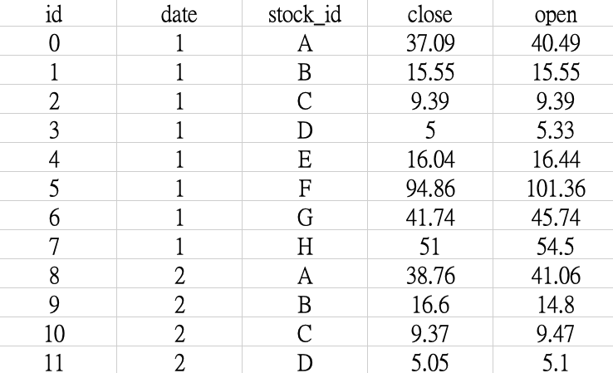
Data Features
training_data.csv
General Features
date: Date of each entry.
stock_id: The stock code, ranging from A to H.
close: Closing price.
open: Opening price.
Other Technical Indicators
MACD, MAMA, PPO...
Additional Notes
91 total features, select what you need for training.
Detailed field description Link

Slide 4
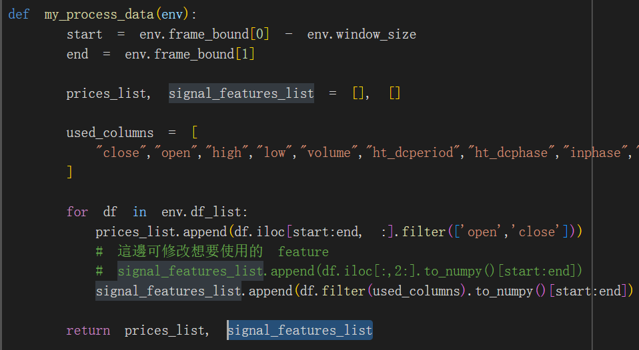
Features Selection
The training data has 91 features, and you can choose any features you want.
example_columns = [ "close","open","high","low","volume","macd","stddev"]
Feature Shape : (8, window_size = 10, 91)
You can add the stock price prediction of Assignments 1 and 2 as features

Slide 5
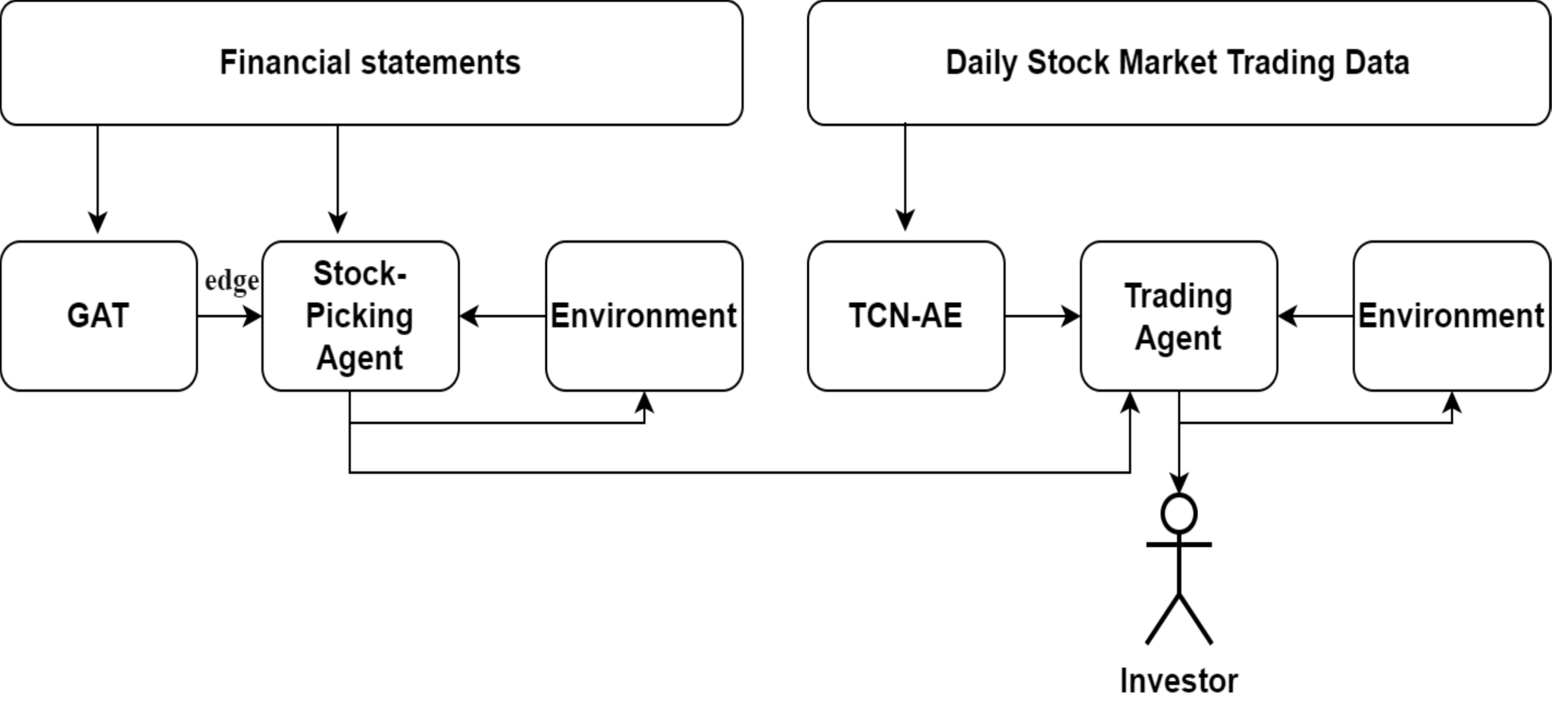
Reference Paper
Portfolio Management via Reinforcement Learning and Graph Attention Network
選股代理人
交易代理人
Through analysis and trading, the two stages can make better predictions

Slide 6
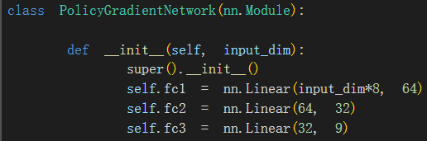
RL Action Format
RL actions (9 preset actions) :
NTD (sell stock) , Buy_S1, Buy_S2, Buy_S3, Buy_S4, Buy_S5, Buy_S6, Buy_S7, Buy_S8
Only hold one stock at a time and can have one action (buy, sell) per day
You can freely modify the RL model or a trading method (hold multiple stocks at the same time)

Slide 7
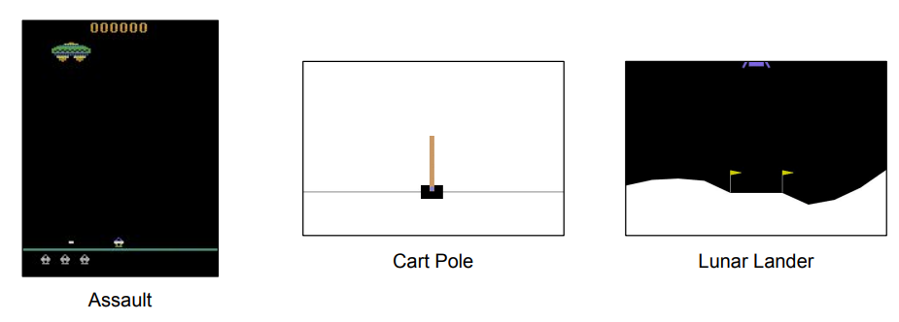
Gymnasium
github
Open source reinforcement learning suite, can be integrated with pytorch
Provides many environments to handle processes such as environmental simulation and rewards, covering simple control problems (e.g., CartPole, MountainCar), classic Atari games (e.g., Pong, Breakout), and simulations based on Box2D and MuJoCo (e.g., BipedalWalker)
We will provide a policy gradient network as a model for trading decisions

Slide 8
gymnasium.Env
Provides a trading environment for single/multiple agents
step() - Updates an environment with actions returning the next agent observation, the reward for taking that actions
reset() - Resets the environment to an initial state
render() - Renders the environments to help visualise what the agent see
close() - Closes the environment
Other parameters
observation - Parameters provided to the RL model to make decisions
action - Actions determined by the RL model and interact with the environment

Slide 9
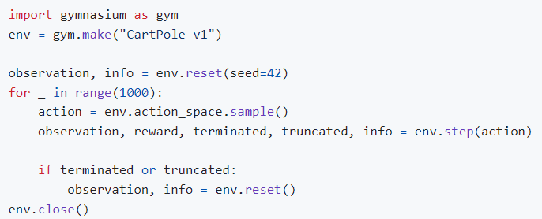
gymnasium.Env
an example using the "CartPole-v1" environment

Slide 10
Reference
REINFORCE js
a JavaScript library for reinforcement learning, particularly suitable for experiments within browsers.
Tianshou
reinforcement learning library based on PyTorch and Gymnasium
provides a variety of reinforcement learning algorithms (e.g., DQN, PPO, A2C)
You can use other packages to implement the algorithms in your reports (python)

Slide 11
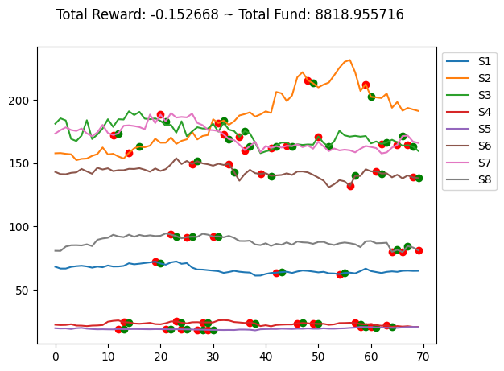
Data Visualization (Random)
This chart shows the price fluctuations of 8 stocks.
The red dots represent buys and the green dots represent sells.
Total Reward
Daily return ratio of stocks held
Can be modified to add handling fees, long-term and short-term trading strategies
Total Fund

Slide 12
Submission

Slide 13
Overview of how to submit your homework
Assignment Instructions
There are Sample Code and Data available for download.
Please ensure that the submitted program can be executed in colab, especially the scoring part
TAs will execute your program and run a private test set to determine your score.
If your program cannot be executed, an announcement will be sent asking you to come to the laboratory.

Slide 14
Overview of how to submit your homework
Files to include ( StudentID.zip ) , Submit to eeClass.
report.pdf
Your report should be in A4-sized PDF format. Include your student ID and name, and answer the questions according to the assignment instructions.
main.py / main.ipynb
The main program for training and testing.
model.ckpt
README.md
Explain your Python 3 version, how to run the code, and any other necessary documentation.
Colab LINK
Any other files you need.
If the file names are incorrect, 5 points will be deducted.
Late submission penalty (max two days) : grade = Original grade × (1 – (days late × 0.1))

Slide 15
Report
template
1.(10%) Policy Gradient method
(1). Please read and run the sample program and try to improve the reward calculation method.
(2). Please explain how you improve the reward algorithm, and how different algorithms affect the training results?
2. (10%) Try to modify and compare at least three hyperparameters (neural network size, number of epochs in a batch, etc.) and explain what you observed.
3. (15%) choose and implement one of the many RL methods such as Q Learning, Actor-Critic, PPO, DDPG, TD3, etc., and describe your implementation details.
4. (5%) Please specifically compare (data, graphs, etc.) the differences between the method you implemented and the Policy Gradient method, and explain their respective differences. What are the advantages and disadvantages of .

Slide 16
Grading Policy
Deadline: 2024/11/21 23:30
You have 2 total late days grace period, late submission penalty: The grade for this assignment = Original grade × (1 – (days late × 0.1))
Programming (60%)
If your code runs successfully and makes predictions, you will receive 20%.
Ranking 40%
The remaining funds are greater than 9,500 , you will receive 20%
The remaining funds are greater than 10,500 , you will receive 30%
Top 1 to 10: (1st place gets 40%, 2nd place gets 39%, and so on.)
Report (40%)
Please output a PDF file in A4 size with the file name: report.pdf (not Report.pdf).
Format error -5%

